Slide 1


Mr. Akashdeep Bhardwaj
School of Computer Science
University of Petroleum & Energy Studies
Bidholi, Via Prem Nagar, Dehradun, Uttarakhand
(AUG-DEC 2024)
BACHELOR OF TECHNOLOGY in
COMPUTER SCIENCE & ENGINEERING
MINOR PROJECT
IP VULNERABILITY
TRACKER
NAME : ROLL NO.
SHREYANSHI DOBHAL : R2142220656
AKSHAT NEGI : R2142220414 ARUSH DUBEY : R2142220314
AMEYA TANEJA : R2142220420
Mentored By:

Slide 2
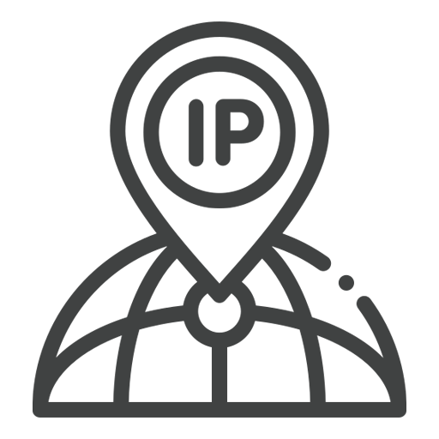
ABSTRACT
NAME : ROLL NO.
SHREYANSHI DOBHAL : R2142220656
AKSHAT NEGI : R2142220414
ARUSH DUBEY : R2142220314
AMEYA TANEJA : R2134567890
This report presents a comprehensive analysis of Internet Protocol (IP) data, focusing on detecting and mitigating security threats within a network. The project leverages advanced algorithms to identify and classify IP traffic anomalies, with the aim of enhancing network security. By analysing sample IP data and employing a reference algorithm, the project aims to highlight vulnerabilities, mitigate risks, and improve overall network efficiency.

Slide 3
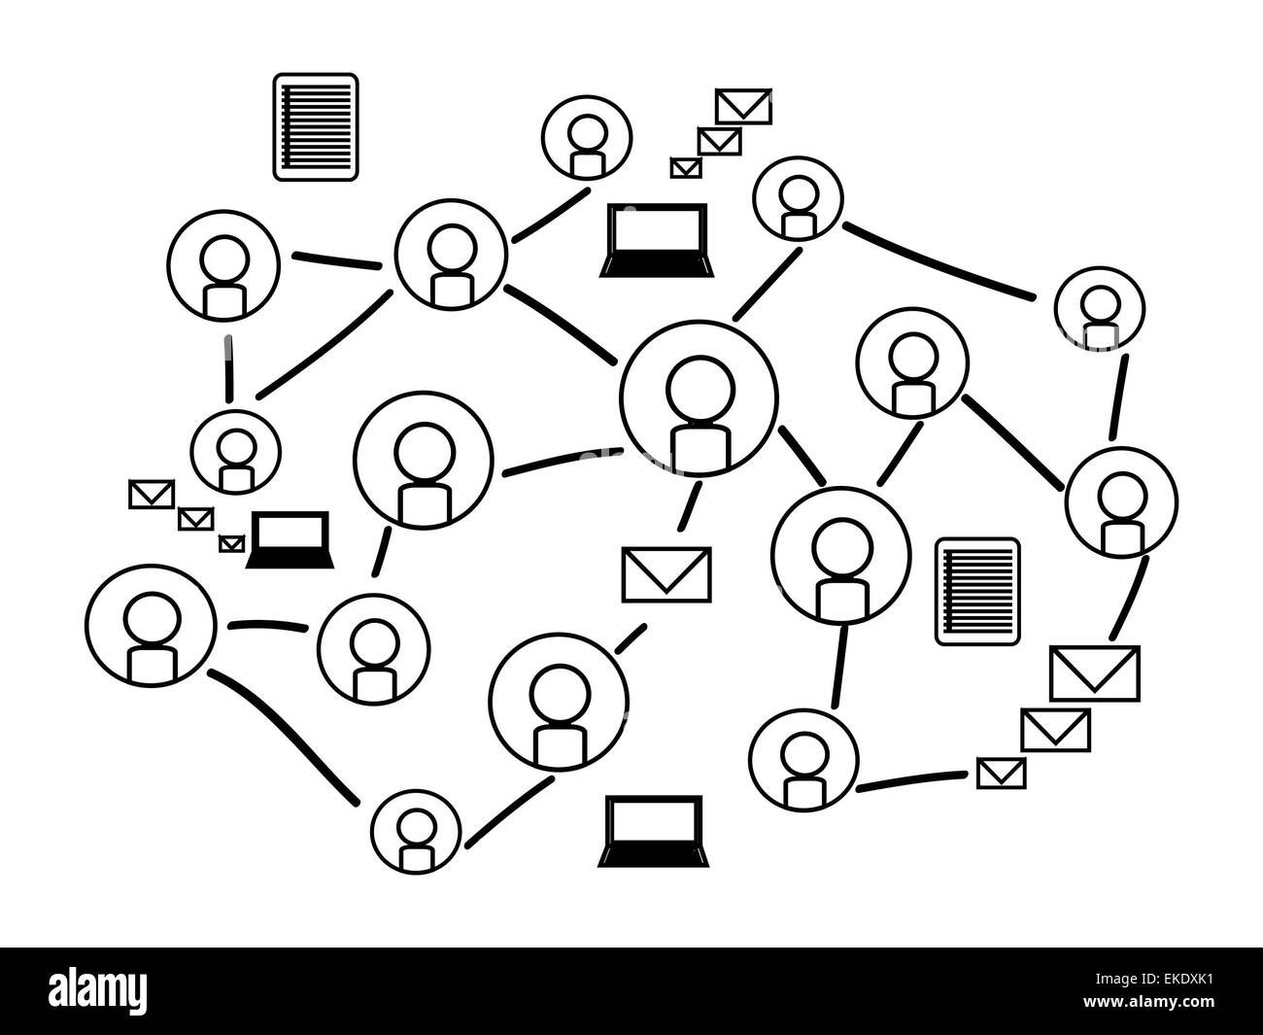
INTRODUCTION
The growing dependence on the Internet and innovation have led to a significant need to safeguard data and networks from cyber threats.
This project aims to analyse IP traffic data using advanced algorithms to identify potential security breaches.
By combining real-time data analysis with automated threat response capabilities.
The project focuses on reliable and fast information about IP, enabling the scalability of large-scale networks.
The goal is to deliver a comprehensive cybersecurity tool that provides comprehensive protection against cyber threats.

Slide 4
PROBLEM STATEMENT
Traditional IP analysis tools are severely limited in their capacity to identify and mitigate security threats in:
Real time due to the complexity and size of modern networks.
Creating a sophisticated IP vulnerability tracker framework in order to address this important problem.
In order to provide a dependable and scalable defence against the ever-changing landscape of cyber risks, the system is built to provide accurate, real-time detection and response to security threats.

Slide 5
STRENGTHS Real-Time Threat Detection: Ensures that malicious activities, such as DDoS attacks or unauthorized access attempts, are detected and mitigated before they can cause significant damage. Scalability: It is highly scalable, making it suitable for large, complex networks with millions of IP connections. | WEAKNESSES Resource-Intensive Processing: This tracker may require substantial investment in computational resources, potentially limiting its accessibility to organizations with smaller IT budgets.
OPPORTUNITIES Integration with Existing Security Infrastructures: Integrated with other security tools like Geolocation and provides a holistic approach to threat management. Customization for Industry-Specific Needs: The system can be tailored to meet the unique security requirements of different industries, such as finance, healthcare, and government. | THREATS Evolving Cyber Threat Landscape: New attack techniques and vulnerabilities may emerge that the current algorithms and data models are not equipped to handle. Data Privacy and Regulatory Compliance: Handling and analysing IP data, especially in regions with strict data protection laws, introduces potential privacy concerns.

Slide 6
PROJECT ARCHITECTURE
The system architecture consists of several key components:
Frontend (ReactJS): The user interface is built with React, providing an interactive dashboard where users can view detailed insights about a website. This includes sections for IP information, SSL chain, DNS records, server location, open ports, and more.
Backend (Node.js/Express): The backend serves API requests from the frontend, processes data, and interacts with the database. It also handles communication with external APIs for additional data retrieval and analysis.
Database (MongoDB): All collected data is stored in a MongoDB database. This includes historical data on IPs, DNS records, SSL certificates, and more, enabling the system to perform trend analysis and provide historical insights.

Slide 7
PROJECT ARCHITECTURE
External APIs:
Rapid API: This API provides information on associated hostnames for a given domain, which is crucial for identifying potential security risks.
Shodan API: It provides information on associated Ports and Vulnerabilities for a given domain.
Who API: Offers comprehensive Whois records, providing detailed domain information that supports the identification of potential vulnerabilities.
Scanning Modules: The system includes various scanning modules that perform specific checks and analyses:
IP Information: Retrieves and analyzes the IP address data of a given website.
SSL Chain: Examines SSL certificates to ensure they are valid and properly configured.
DNS Records: Collects and analyzes DNS records, including TXT and A records, to ensure proper configuration and security.
Open Ports: Scans for open ports on the server, which could be potential entry points for attackers.
HTTP Security Features: Analyzes HTTP headers and other configurations to assess the website’s security posture.
Site Performance and Carbon Footprint: Measures the website's performance metrics and evaluates its environmental impact based on energy consumption.

Slide 8
PROJECT ARCHITECTURE
Data Flow:
Data Collection: The frontend sends a request to the backend to analyse a specific website. The backend orchestrates the scanning process by invoking the relevant scanning modules and external APIs.
Data Processing: The results from the scanning modules and external APIs are processed and stored in the database. The backend also performs additional analysis, such as identifying trends or anomalies in the data.
Data Presentation: The processed data is sent back to the frontend, where it is displayed on the dashboard. Users can view detailed information about the website’s security, performance, and environmental impact.
API Configuration:
To enhance the system’s capabilities, the following environmental variables can be configured:
RAPID_API_KEY: For accessing website DNS metrics.
SHODAN_API_KEY: To retrieve associated hostnames via Shodan.
WHO_API_KEY: For obtaining comprehensive Whois records.

Slide 9
SYSTEM DESIGN
The system is designed to be both robust and adaptable, using a combination of APIs and a central database to gather and analyse detailed information about websites.
This approach enables us to provide insights into various aspects, such as IP details, SSL chains, DNS records, and server configurations.
One of the key components of the system is its comprehensive dashboard, which serves as the main interface for users.
Users can track a variety of important metrics, including IP information, SSL chain integrity, DNS records, and open port status.
Additionally, it offers insights into site performance, security settings, and potential vulnerabilities, making it a practical tool for both technical teams and decision-makers.
Future Work:
Scalability is a central consideration, ensuring that the system can manage increased data loads as more websites are analysed.
It’s also built to integrate smoothly with other security tools, making it a flexible addition to any organization’s security setup.
In the future, we plan to incorporate web vulnerability exploitation tools which allow the system to test how well websites hold up against potential hacks, offering deeper insights into their security resilience.

Slide 10
FRONTEND DESCRIPTION
The system is designed in modern frontend framework i.e React to handle dynamic routing. The typical routes that are used in the project are:
Home: Provides an introduction to your tool, highlights its features, and explains how it works.
IP Tracker: The core functionality page for checking vulnerabilities.
APIs used in the IP tracker field provide information of : Domain, SSL certificate information, Geolocation information, Port information, Domain related news, and weather information of the particular region where the domain is tracked.
About: Provides detailed information of the team members.
Legal : Displays legal information of the services.
Contact: Allows user to reach out for support, feedbacks and inquires.
Login: Allow users to authenticate and access protected features of the application.
SignIn: Allow new users to create a new account and access protected features of the application.
Future enhancements
It’s also built to integrate smoothly with other security tools, making it a flexible addition to any organization’s security setup.
In the future, we plan to incorporate web vulnerability exploitation tools which allow the system to test how well websites hold up against potential hacks, offering deeper insights into their security resilience.

Slide 11
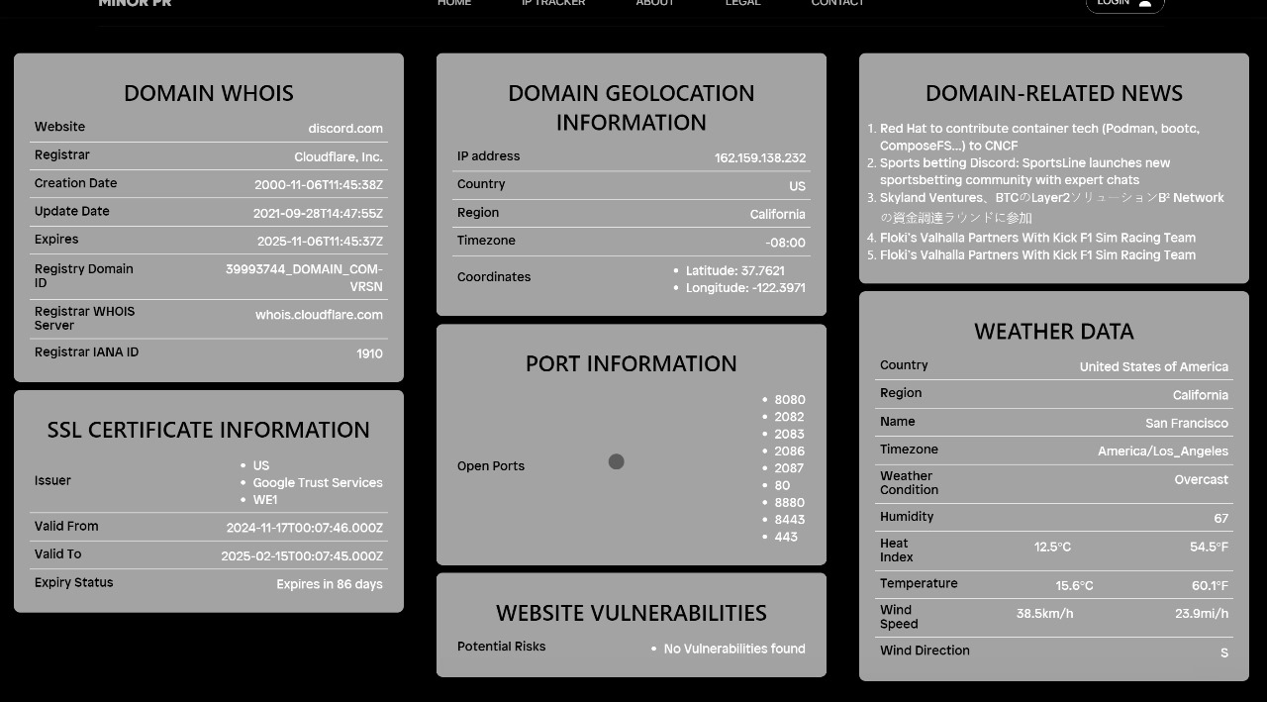

Slide 12
DATABASE DESCRIPTION
The database is a critical component of an IP Vulnerability Tracker, used to store and manage all relevant data securely and efficiently. The database serves to:
Store scan results, vulnerability details, and metadata.
Maintain user accounts, roles, and preferences.
Provide historical data for trends, reporting, and audits.
The main area of concerns are:
Login logs:
User behavior analysis
Incident response
Security
Monitoring
Sign-In logs:
The key purpose for sign in logs are:
Security and Threat detection
System performance
Incident investigation

Slide 13
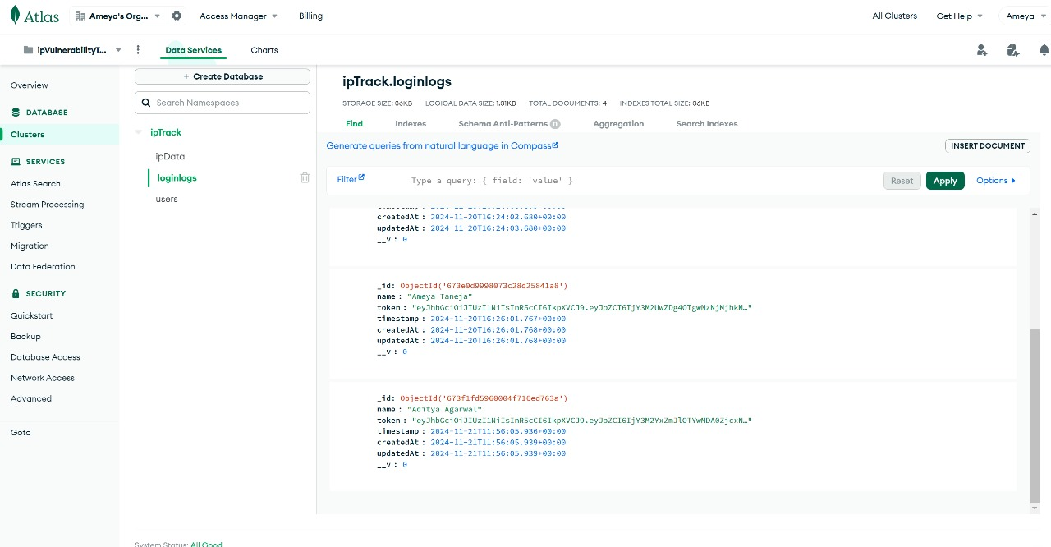

Slide 14
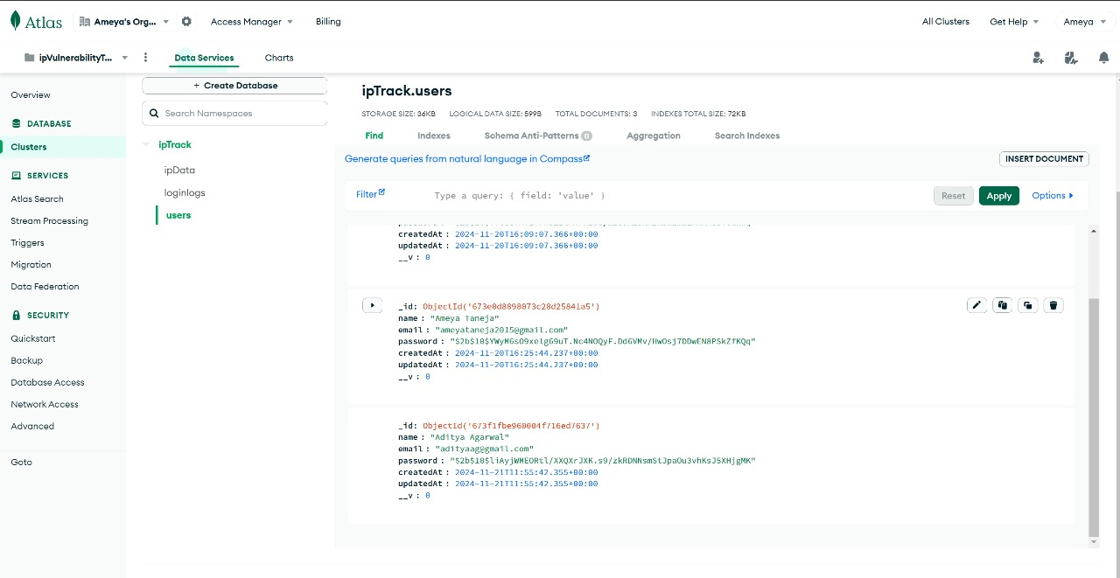

Slide 15
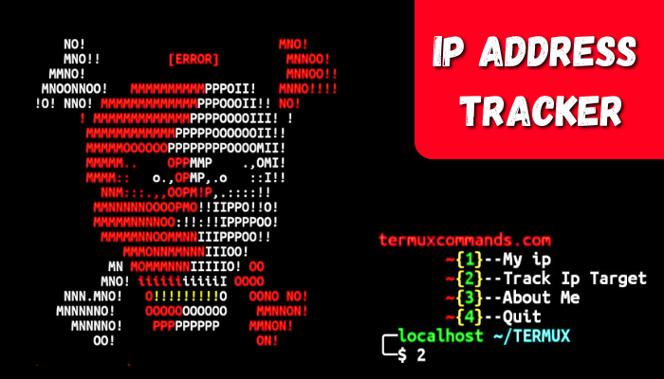
AREA OF APPLICATION
1. Corporate Network Security
Use: The system continuously monitors enterprise networks for anomalies and potential security breaches, offering real-time analysis and threat detection.
Helpfulness: Ensures the integrity of business operations, and mitigates risks associated with cyber threats.
2. Financial Sector
Use: The system monitors transaction networks and online banking platforms to detect and analyse fraudulent activities and security breaches.
Helpfulness: It plays a vital role in safeguarding financial transactions, protecting sensitive customer information, and preventing potential financial losses from cyber-attacks.

Slide 16
AREA OF APPLICATION
3. E-Commerce Platforms
Use: The system evaluates online retail environments by analysing traffic patterns for fraudulent transactions and potential security threats.
Helpfulness: It helps secure payment information, maintain customer trust, and mitigate risks that could adversely affect the business’s reputation and operational stability.
4. Healthcare Industry
Use: The system assesses network security within healthcare environments to protect patient data and safeguard critical healthcare systems from cyber threats.
Helpfulness: It ensures the confidentiality and integrity of sensitive health information, supports compliance with data protection regulations, and contributes to overall data security in the healthcare sector.

Slide 17

FUTURE ENHANCEMENTS
In the future,
We plan to integrate web vulnerability exploitation tools into the system.
This addition will allow for comprehensive assessments of a site's defences.

Slide 18

THANK YOU

